Slide 1
GROUP 3: CAR CAUTIOUS ALERT DETECTOR
Ooi Zheng Ming & Athirah

Slide 2
INTRODUCTION
AEB system will automatically brakes to the vehicle when the obstacle is detected by using radar and camera.
Suggested system:
real-time car detection module
smart car front light system module
-Ultrasonic sensor is used in the automobile detection module
-Servo motor acts as brake of the car and the buzzer will sound when in dangerous distance
-The smart car front light system module is made up of LDR and LEDs

Slide 3
Problem Statements
One of the main causes of the car accident is due to drivers finding it hard to measure the distance of the approaching object when reverse
Random error occurs as the driver is unable to measure the actual distance themself
Unable to identify the distance with approaching objects and increase the chances of collision
Vehicles are unable to stop immediately when colliding with the approaching object.

Slide 4
OBJECTIVES
To design a system that measures and indicates the distance between the car and the approaching object.
To design a system enables vehicles to identify the level of light in the speedometer
To design a warning system with alarm warning, LED status, and the car will automatically stop instant when it detects the car is approaching with an object at a specified distance.

Slide 5
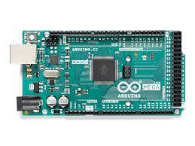
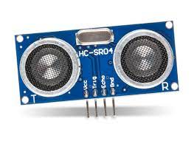
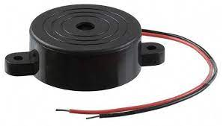
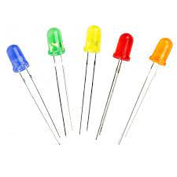
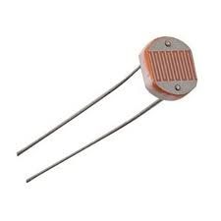
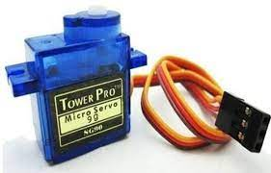
Equipment Used
Arduino Mega 2560
Buzzer
Ultrasonic Sensor
LEDs
Servo motor
LDR Sensor

Slide 6
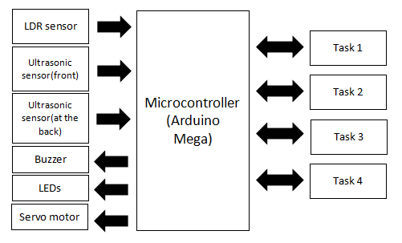
Block Diagram

Slide 7
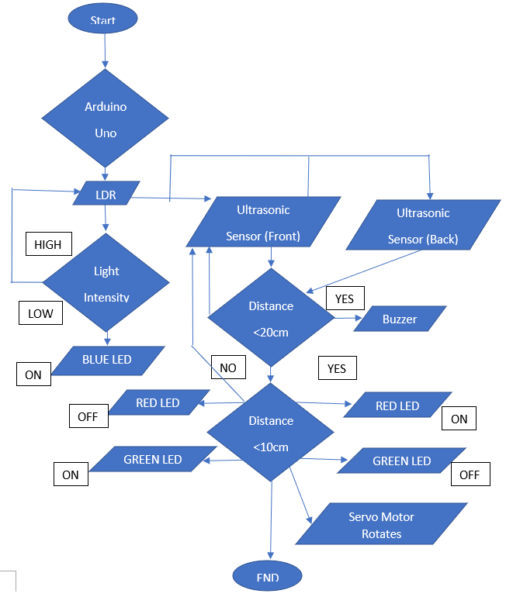
Flowchart

Slide 8

Results

Slide 10
Conclusions
As a conclusion, the implementation of freeRTOS features into Arduino code has enhanced the systems’ performance. The system speed and time is optimized, by allowing tasks to be executed at the same time and also able to halt and continue tasks whenever they are called upon. The project was successfully simulated in the Proteus software, and the output obtained is identical to the expected results. Besides that, the hardware output of the project also showed the same result as the simulation. Nevertheless, the physical hardware outcome has some limitations, such as the LEDs having lower brightness. Overall, the project was successfully carried out and met the expectations.

Slide 11
References
Arduino-based Collision Detection Warning System. (n.d.). Arduino Project Hub. Retrieved June 9, 2022.
D. Culbert, “System and method for dynamic resource management across tasks in real-time operating systems,” U.S. Patent 5 838 968, Nov. 17, 1998.
Shimazaki, K., Ito, T., Fujii, A., & Ishida, T. (2018). The public’s understanding of the functionality and limitations of automatic braking in Japan. IATSS Research, 42(4), 221–229
Lee, Y (2010, Dec) Intelligent Safety Warning and Alert System for Car Driving. Research Gate.
Massimo, B., & Shiloh, M. (2014). Getting Started with Arduino: The Open Source Electronics Prototyping Platform. Maker Media, 15-23.

